Slide 1


JAVA OOP
ITE64 - Integrative Programming and Technologies

Slide 2
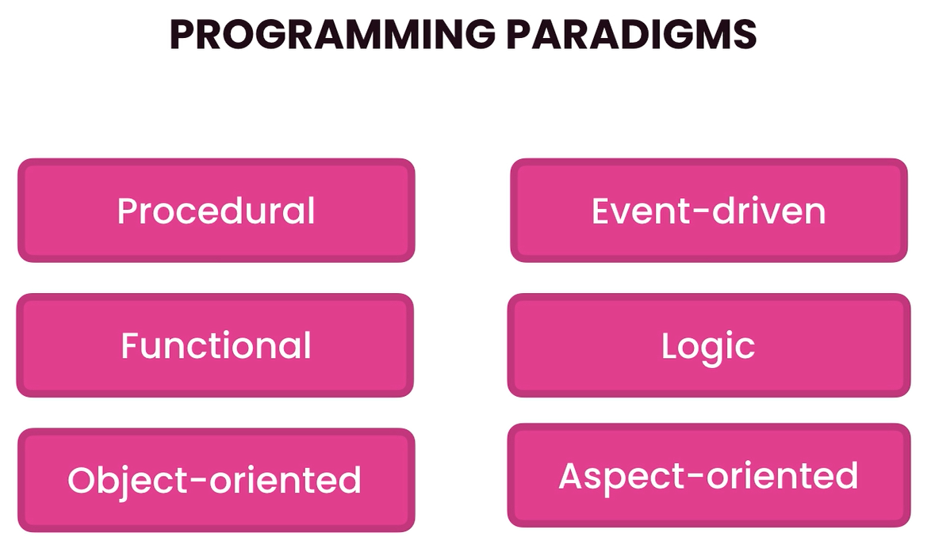
Programming Paradigms
- ways or syles of writing codes

Slide 3
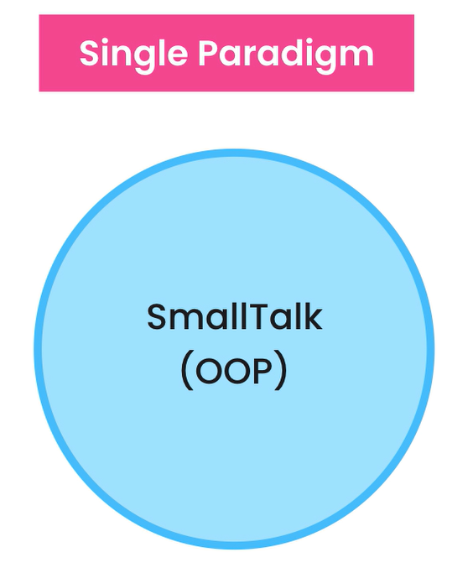
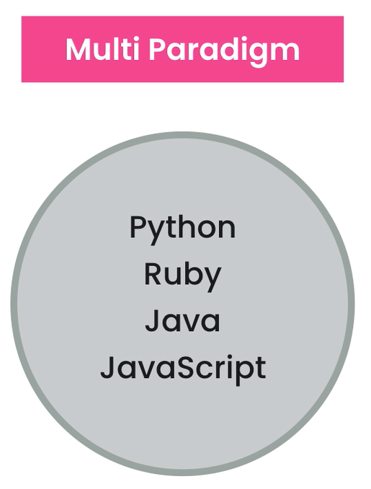
Programming Paradigms

Slide 4

In OOP, everything is based on the concepts of objects
Objects are units based on data(or state) and operations on data called methods(or behavior)
Object Oriented Programming

Slide 5
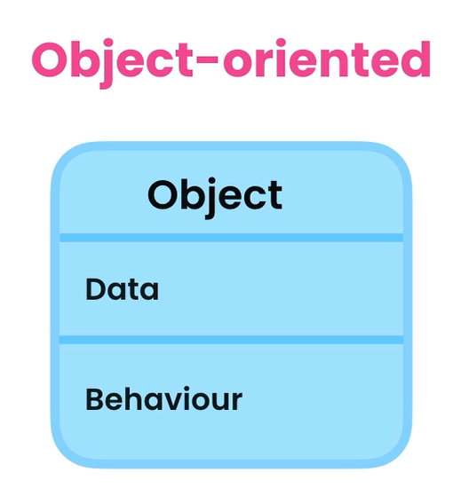
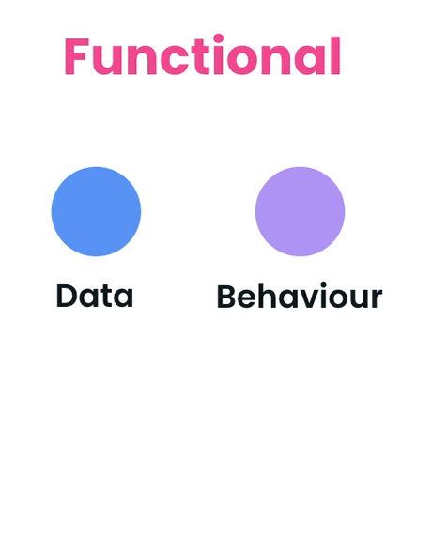
OOP vs Functional

Slide 6
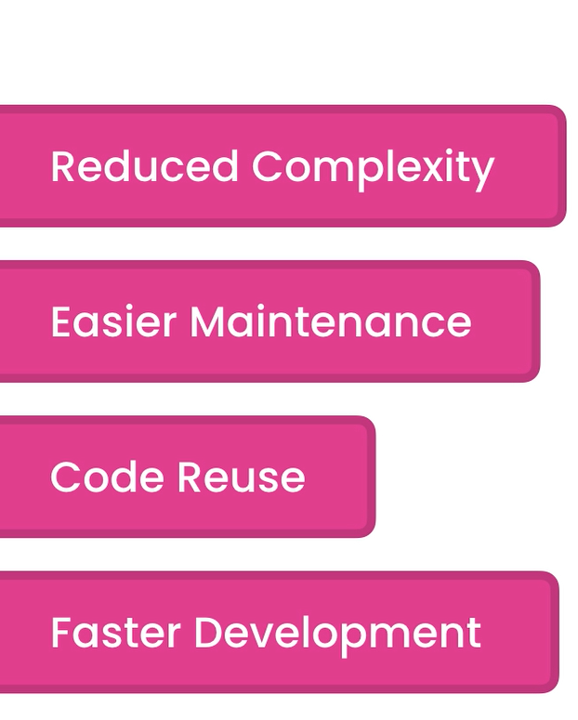
Benefits
breaking down a large complex application into smaller, manageable objects
if an object is not working properly, we can only focus fixing that object
more opportunity to reuse code in other applications
less time building applications

Slide 7
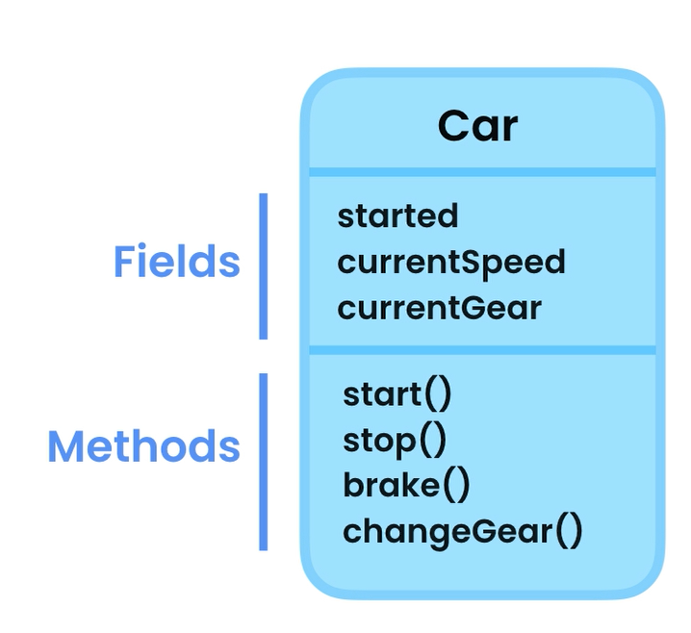
Classes and Objects
A class is a blueprint for creating objects
An object is an instance of a class
Car myCar = new Car();

Slide 8

Question
What state and behavior can a class TV have?

Slide 9
Creating classes
Creating objects
- use Pascal naming convention
- use nouns
- create class members
- create constructor/s
- create method/s
Syntax:
Object objName = new Object();

Slide 10
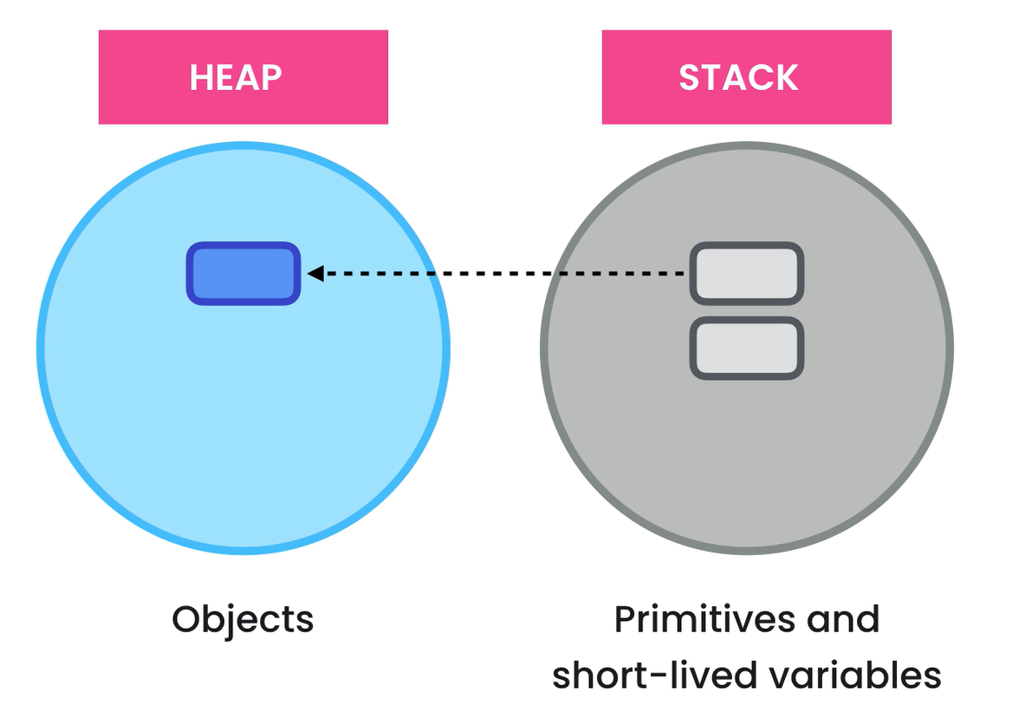
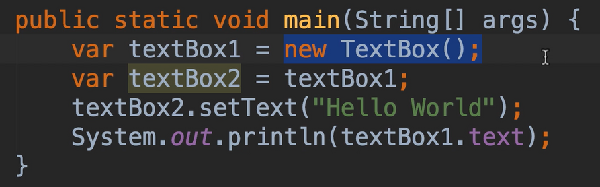
Memory Allocation

Slide 11
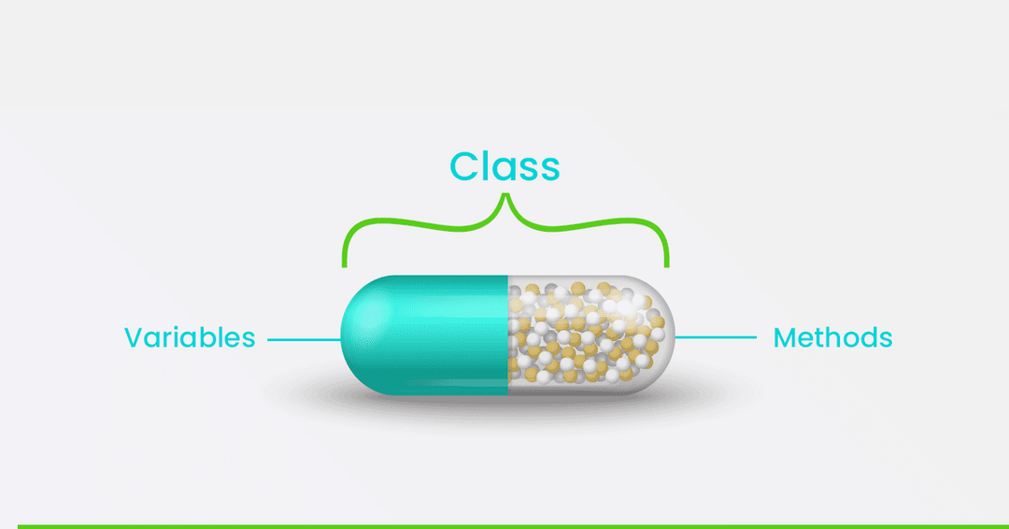
Encapsulation
Bundle the data and methods that operate on the data in a single unit
- make fields private
- use setters and getters to ensure that fields can only be accessed and altered only in the same class

